Slide 1

11th i-CoMSE Workshop: Mesoscale particle-based modeling
Multiparticle Collision Dynamics I
Session 10: Algorithm, Pure Solvent

Slide 2
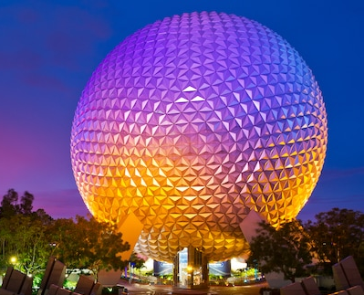
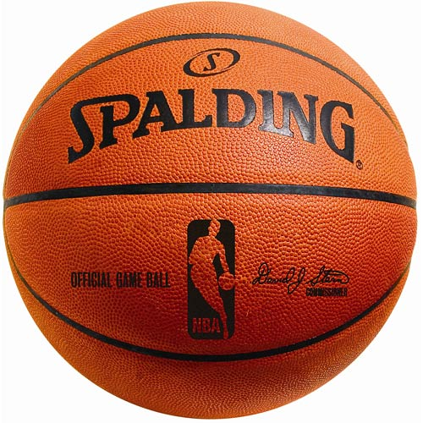
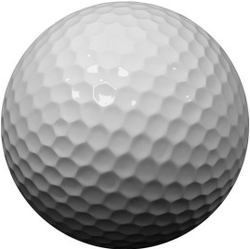
scale disparity is a big Challenge
3Å
water
2 nm
350 nm
nanoparticle

Slide 3
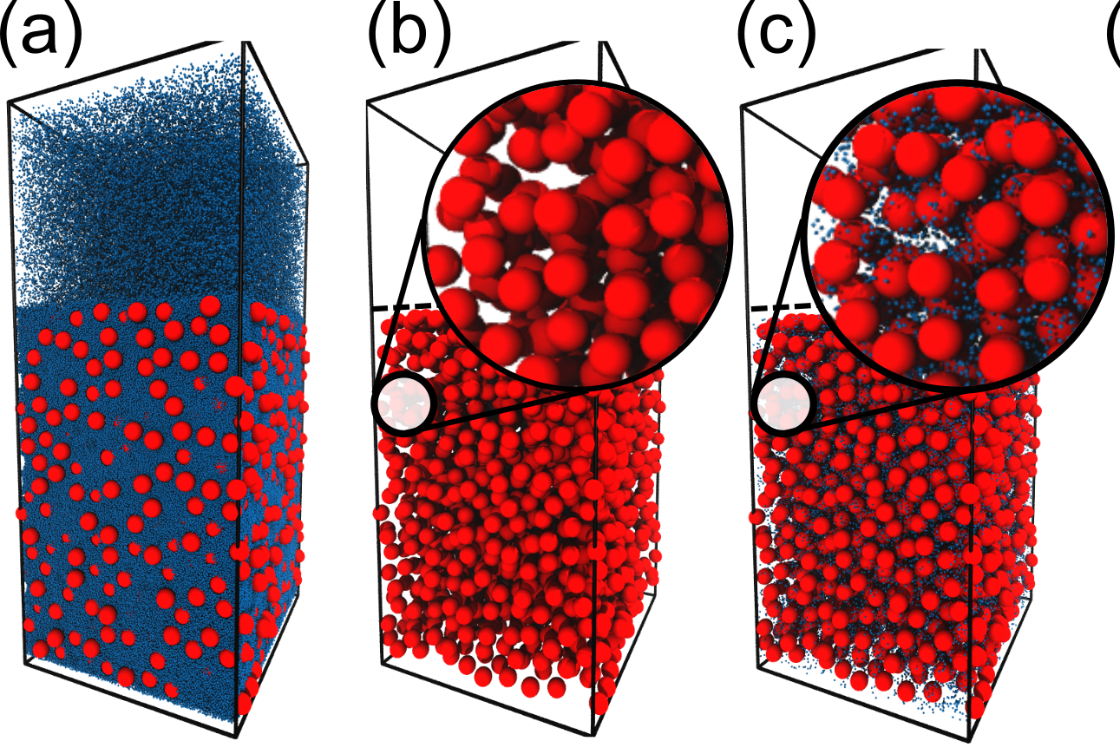
Implicit and mesoscale solvents
Brownian dynamics
Stokesian dynamics
Lattice Boltzmann
Dissipative particle dynamics
Multiparticle collision dynamics (MPCD)

Slide 4
The algorithm
Incorporates hydrodynamic interactions at small computational cost because there are no pair forces between solvent particles (an “ideal gas” solvent).
stream
collide
A. Malevanets and R. Kapral. J. Chem. Phys. 110, 8605 (1999).

Slide 5
Initialization
MPCD particles are an ideal gas, so you can usually put them “anywhere” inside the volume of the simulation box they are allowed to be in. You choose the average density. (Uniform random numbers.)
Velocities should become Maxwell–Boltzmann distributed. You can initialize them that way, but be careful that there is no net velocity. (Gaussian random numbers.)
The natural MPCD units are the particle mass m, the cell size ℓ, and the thermal energy k_{B}T.

Slide 6
The collision step
Stochastic rotation dynamics
A stochastic procedure for exchanging momentum between particles that are all in the same spatial “cell”.
The original (and most popular) flavor of MPCD is stochastic rotation dynamics (SRD). Velocities are rotated about the center of mass velocity of a cell.
This rule conserves linear momentum and kinetic energy but must be modified to conserve angular momentum.
3D rotation by fixed angle about random axis

Slide 7
The collision step
Stochastic rotation dynamics With Thermostat
A thermostat can be added to the SRD collision to maintain constant temperature. Temperature is computed at the cell level relative to the average velocity.
A velocity rescaling factor is computed for each cell by drawing a target K from its equilibrium distribution.

Slide 8
The collision step
Andersen thermostat
Andersen thermostat is an alternative collision scheme that works similarly to the thermostat for MD simulations.
A random change in the velocity is drawn for each particle, with the requirement that the sum of changes in a cell adds up to zero.
This scheme is inherently thermostatted because a temperature is needed to draw the random velocities.

Slide 9
Practical implementation
Typical MPCD simulations require many particles with simple interactions
( 5 particles per cell ) x ( 1003 to 2003 cells ) = 5 to 40 million particles
MPCD readily lends itself to parallelization because of its particle- and cell-based nature.
Particle sorting improves performance without changing results (cache coherency).
7
3
2
9
6
4
7
3
2
9
6
4
2
2
1
1
3
3
threading
(GPUs)
domain decomposition
(many nodes)
6

Slide 10
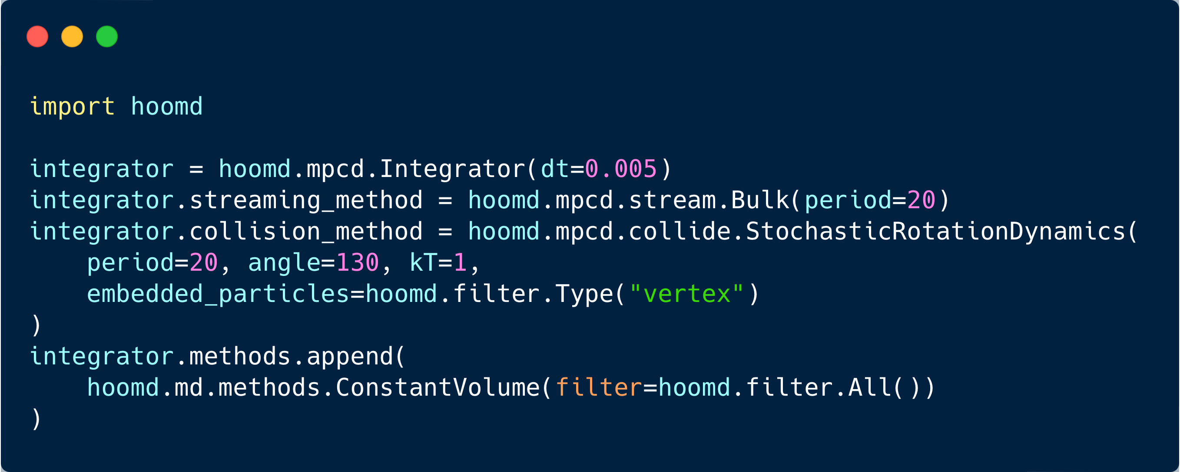
Practical implementation
MPCD is freely available in HOOMD-blue.
Also available to some extent in LAMMPS (build with SRD package).
M.P. Howard, A.Z. Panagiotopoulos, and A. Nikoubashman. Comput. Phys. Commun. 230, 10 (2018).

Slide 11
Practical implementation
Strong scaling: if I double my resources, do I solve my problem twice as fast?
Weak scaling: if I double my resources and my problem size, does it take the same amount of time?
strong
weak

Slide 12
Exercise: Diffusion Coefficient
Reminder on definition of diffusion coefficient from mean squared displacement
Calculate mean squared displacement for MPCD solvent. Extract diffusion coefficient and compare to theoretical expression based on kinetic theory of gases.

Slide 13
Exercise: Mapping solvent properties
If we set ℓ = 3 Å (water) and T = 298 K, then match density to determine m:
Close but not quite! How about the diffusivity? This behavior is typical of many mesoscale methods, and the solvent should be considered “liquid like.”
 | density | model viscosity | actual viscosity
SRD | 5 m/ℓ³ | 3.40 k_{B}T 𝜏/ℓ
water | 997 kg/m³ | ? mPa s | 0.89 mPa s
hexane | 655 kg/m³ | ? mPa s | 0.30 mPa s
T. Ihle and D.M. Kroll. Phys. Rev. E 67, 066706 (2003).
J.T. Padding and A.A. Louis. Phys. Rev. E 74, 031402 (2006).

Slide 14
summary
Why MPCD?
“Add on” to existing coarse-grained molecular dynamics models and tools.
Stationary and moving boundaries.
Suspended particles.
Shockingly cheap.
Why not MPCD?
Imperfect solvent-property matching.
Not a true incompressible Stokes flow.
Multiphase fluids are difficult to handle.

